Slide 1
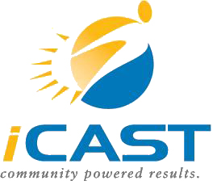
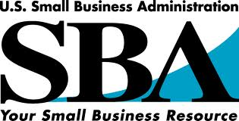
Community ECONOMIC Development
A Guide to Choosing the Appropriate Economic Development Model for Your Community
SBA Disclaimer
This U.S. Small Business Administration (SBA) Cooperative Agreement is partially funded by the SBA. SBA's funding is not and endorsement of any products, opinions or services. All SBA funded programs are extended to the public on a non-discriminatory basis.

Slide 2
Agenda
Introduction to iCAST
Models for Community Economic Development
Choosing the Optimal Approach
Case Study
Next Steps?

Slide 3
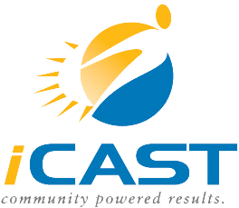
iCAST Mission
To provide economic, environmental, and social benefits to communities in a manner that builds local capacity
Environmental Stewardship
Social Responsibility
Economic Development

Slide 4
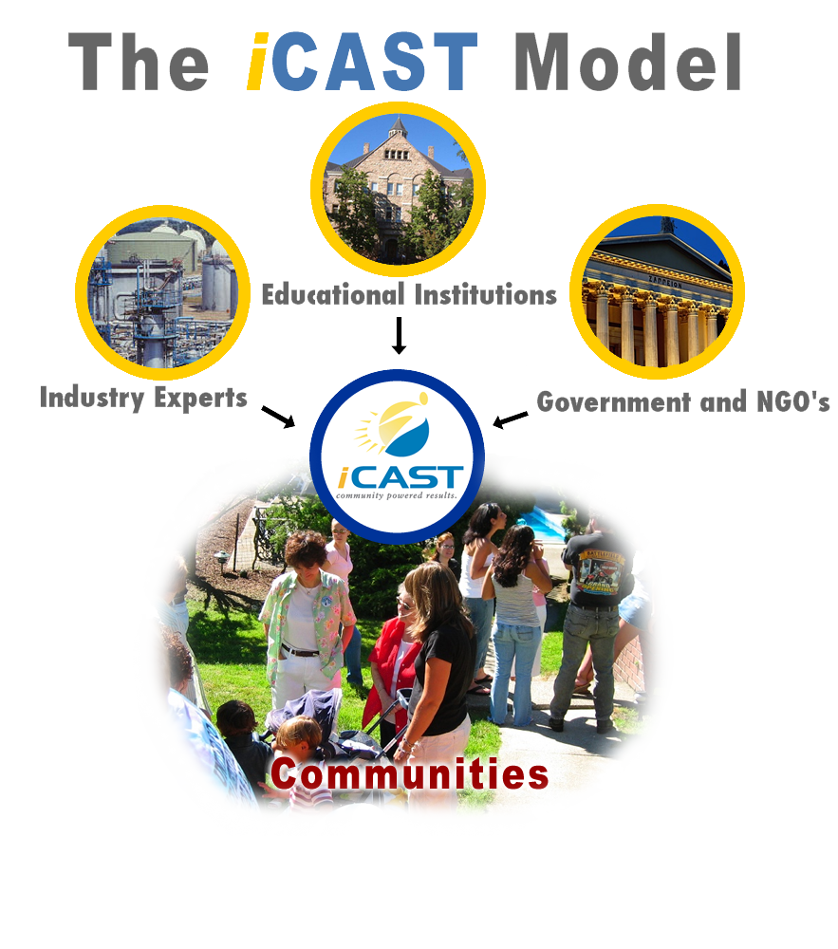

Slide 5
Accomplishments
Promoted the launch of eight for-profit start-ups and advised dozen’s of small businesses
Created 100+ Jobs & placed 250+ into ‘Green Collar’ Jobs
Created direct economic impact worth over $25 Million and in-direct economic impact worth over $200 Million;
2011:
Saves 5M kWh and reduce CO2 emissions by 8M lbs
Engaged 200+ university students in community projects
Serve 1,000+ low income households, non-profits, etc.
Train 500+ and provide employment to 100+ unemployed

Slide 6
Economic Development Models
Traditional
Economic Gardening
Enterprise Facilitation
Hometown
Competitiveness
Theory of
Clusters
Multi-Modal
Systems

Slide 7

Traditional Method
How it works:
“Chasing” and “acquiring”
Works for small and large communities
An attractive financial incentive
Pros:
Better paying jobs
Attracts outside suppliers
Stimulates employment and tax revenues
Cons:
Low community engagement
Pressure on already established employers
Higher taxes for companies and citizens
“Smokestack Chasing” and Acquisition

Slide 8
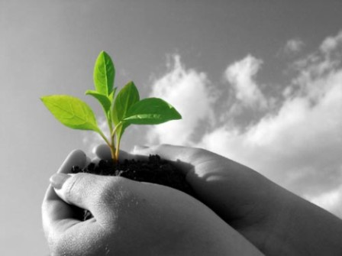
Economic Gardening
How it works:
A form of asset-based development
Focuses on existing businesses
Brings new ideas, processes, and unique products
Who works for:
Small- to medium-sized communities
Firmly established business
Pros:
Focuses on strengths of the community
Keeps enthusiasm at high levels
Resources used to strengthen existing business
Cons:
Historically not efficient in small isolated communities
“Commodity trap”

Slide 9
Enterprise Facilitation
How it works:
“Enterprise Facilitation Committees” and facilitators
Provides moral and technical support
Engages local business owners on similar interests
Who works for:
Any rural or urban city willing to pay and train enterprise facilitators
Pros:
Provides free counseling to entrepreneurs
Facilitates Networking
Cons:
Slow on job creation

Slide 10
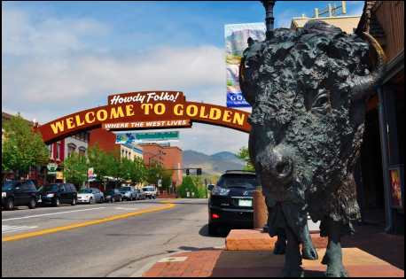
Hometown Competitiveness
How it works:
Uses inward resources
Emphasis on the young citizens of the community
Who it works for:
Works best in small, rural communities
Pros:
Youth Engagement
Creates leadership
Builds on local assets
Cons:
Lacks experienced leadership

Slide 11

Theory of Clusters
How it works:
Assembles qualitative and quantitative information
Identifies relationships between costumers and suppliers
Product/process innovations
Who it works for:
Any community with an established commercial and industrial sector
Pros:
Flexible and dynamic
Can work for virtually any industry
Knowledge-driven
Cons:
It is an analytical method
Notes:
Michael Porter developed the cluster theory

Slide 12
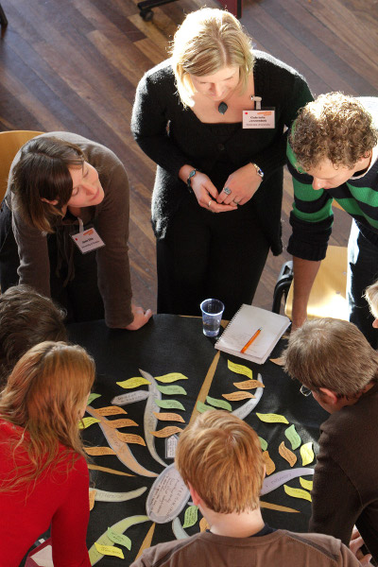
Multi-Modal System
How it works:
Approach to systems science and theory of modal spheres
Captures knowledge through social and technical sciences
Expands existing economic development approach
Who it works for:
Anyone, but more efficiently in small to medium
sized communities
Pros:
Flexible and dynamic
Comprehensive and identifies relationships
Addresses complex normative factors
Cons:
Complex
Time consuming
Notes:
Reasoning under uncertainty

Slide 13
CDC & CDFI
How it works:
CDC’s and CDFI’s anchor capital locally through development of residential and commercial property and businesses
Develop economic plans for sustainable growth
Who it works for:
Virtually everyone
Pros:
CDC’s and CDFI’s exist everywhere
Low cost for community
Contributes positively to overall growth
Cons:
Only focuses on low/moderate income residents

Slide 14
http://www.icastusa.org/iCAST_Community_Development.pdf

Slide 15

How to Choose?
All of the development models provide something positive to a community
Resource limitations require a choice.
The correct choice can yield results
Figuring out the optimal solution can be a challenge

Slide 16
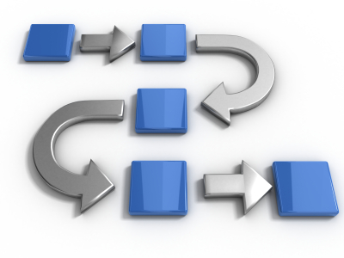
Decision Matrix Process
Steps to choosing an optimal economic plan
Determine key selection criteria
Evaluating each criterion by importance to your community
Rating each criterion for each model you wish to consider
Merge the importance of each selection criteria with the rating for each approach

Slide 17
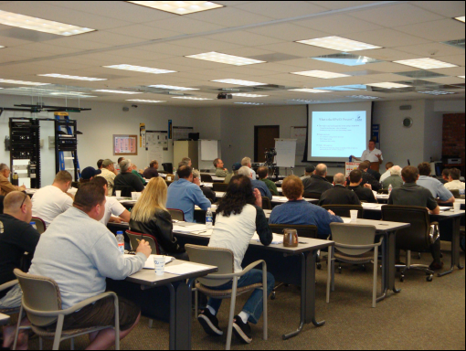
Case Study
Community of Flannery
Criteria | Rating
Cost | 10
Technical viability | 7
Ability to obtain necessary approvals | 4
Reliability/Consistency | 6
Environmental Impact | 3
Likely # of jobs created in Flannery | 9
Sustainability of Jobs | 8
Time to achieve results | 5

Slide 18

Community of Flannery
Criteria | Hometown Comp. | Economic Gardening | Enterprise Facilitation
Cost | 9 | 10 | 7
Technical viability | 7 | 9 | 8
Ability to obtain necessary approvals | 9 | 8 | 6
Reliability/Consistency | 6 | 7 | 10
Environmental impact | 5 | 8 | 8
Likely # of jobs created in Flannery | 6 | 7 | 6
Sustainability of Jobs | 8 | 10 | 8
Time until results achieved | 5 | 7 | 7

Slide 19
Community of Flannery
 |  | Weighted Score
Selection Criteria | Imp. | Hometown Comp. | Economic Gardening | Enterprise Facilitation
Cost | 10 | 9*10 = 90 | 10*10 = 100 | 7*10 = 70
Technical viability | 7 | 7*7 = 49 | 9*7 = 63 | 8*7 = 56
Ability to obtain necessary approvals | 4 | 9*4 = 36 | 6*4 = 36 | 6*4 = 24
Reliability/Consistency | 6 | 6*6 = 36 | 7*6 = 42 | 10*6 = 60
Environmental impact | 3 | 5*3 = 15 | 8*3 = 24 | 8*3=24
Likely # of jobs created in Flannery | 9 | 6*8 = 48 | 7*8 = 56 | 6*8 = 48
Sustainability of Jobs | 8 | 8*8 = 64 | 10*8 = 80 | 8*8 = 64
Time to achieve results | 5 | 5*5 = 25 | 7*5 = 35 | 7*5 = 35
Total |  | 363 | 436 | 381

Slide 20
Process
Understand your community’s Needs and Resources
Establish goals/objectives
Tabulate your current resources
Conduct a SWOT analysis
Determine Optimal Economic Development Model
Determine Selection Criteria and their importance
Conduct Decision Matrix Process
Develop Business Plan
Execute on Plan

Slide 21
Types of Capital
Natural Capital
Cultural Capital
Physical Capital
Natural ecosystem goods and resources
Knowledge,
skills, education
Property, plant, and equipment
Social Capital
Economic Capital
Human Capital
Networks of influence & support
Market value of your assets and liabilities
Competency and knowledge resources
Notes:
When following an “asset-based methodology” which, as mentioned before focuses on the strengths and resources within a community, it is important to look at the various forms of capital available. Looking at the types of capital within a community is crucial because it is the beginning at deciding what economic method would best within the community in practice.

Slide 22
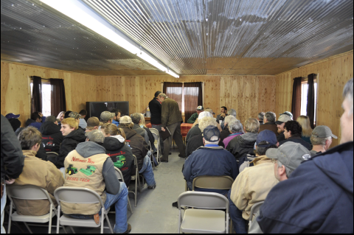
Starting the Process
Establish Goals
Identification of needs and assets
SWOT Analysis
Political and economic reality
Identify necessary resources
Identify local champions
Establish a timeline and scope
Launch

Slide 23

Summary
Sustainable Development versus Economic Development
Strategies for Growth and Sustainability
Traditional Recruiting Model versus an Asset-based Approach
Know your community and what will work for it
Develop appropriate plan for your community

Slide 24
Thank YOU
Ravi Malhotra
President, iCAST
303-462-4100 *801
ravi@icastusa.org
http://www.icastusa.org/iCAST_Community_Development.pdf

Slide 25
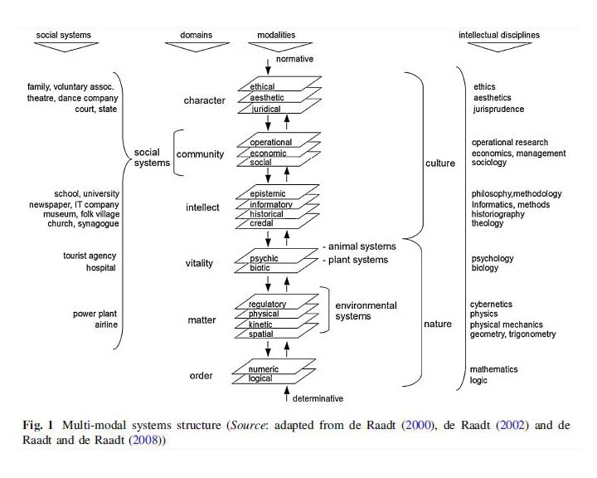
Multi Modal Systems

Slide 26
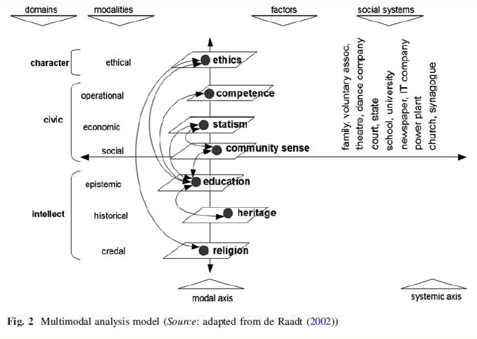
Multi Modal Sytem

Slide 27
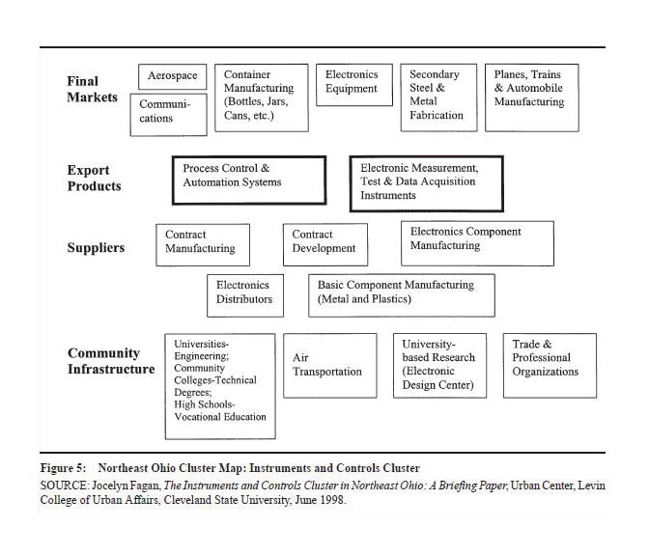
Theory of Clusters Diagram

Slide 28
Economic Gardening
The most used economic method after the traditional one is “economic gardening”, simply because it is flexible and it can be incorporated pretty much on any medium-size community
Also economic gardening can be implement in communities where people look for exactly the opposite than “traditional method”. Economic gardening is exclusively focus on developing the skills and talents within the community making it more self sustainable. The traditional method looks for outside capital, which can be good for the community economically, but doesn’t help neither to the moral or the environment of the community

